Slide 1
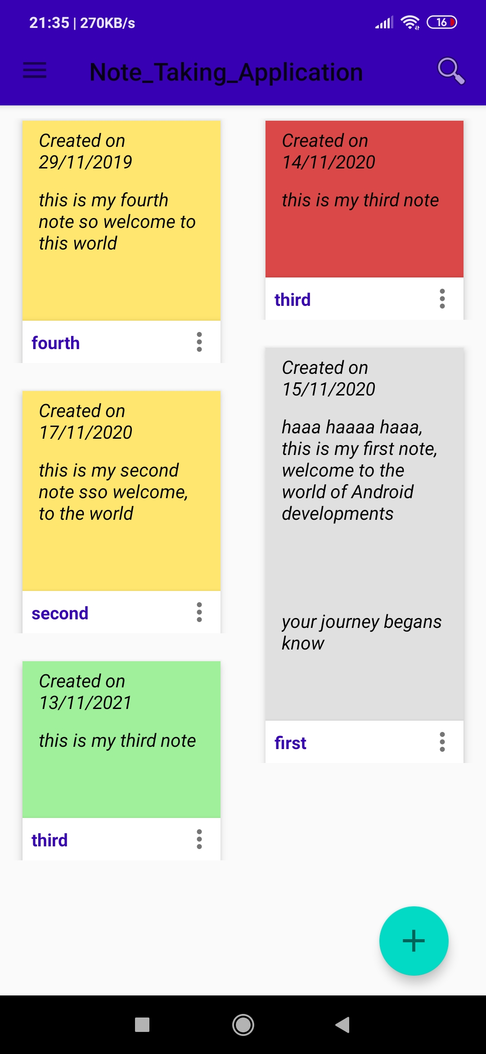
Note Taking Application
This presentation is on Note TAKING App which is made with the help of firebase and cryptography for android user

Slide 2
CONTENT
INTRODUCTION
TECHNOLOGY USED
HARDWARE REQUIREMENT
WHY ANDROID ?
ANDROID ACTIVITY LIFECYCLE
APPLICATION FEATURE
APPLICATION DESIGN OVERVIEW
SNAPSHOT
FUTURE WORK
LEARNING FROM PROJECT

Slide 3
INTRODUCTION
Smart phones have become increasingly powerful in recent years. Dramatic breakthroughs in processing power along with number of extra features include in this devices have opened the doors to a wide range of commercial possibilities.
My project motivation is to provide simple note taking app , which help the user to add, edit, and delete the note with the minimum knowledge about technology and this app also ensures that their notes are safe and secure , this app also allow user to access their notes from any part of the world and from any android device

Slide 4

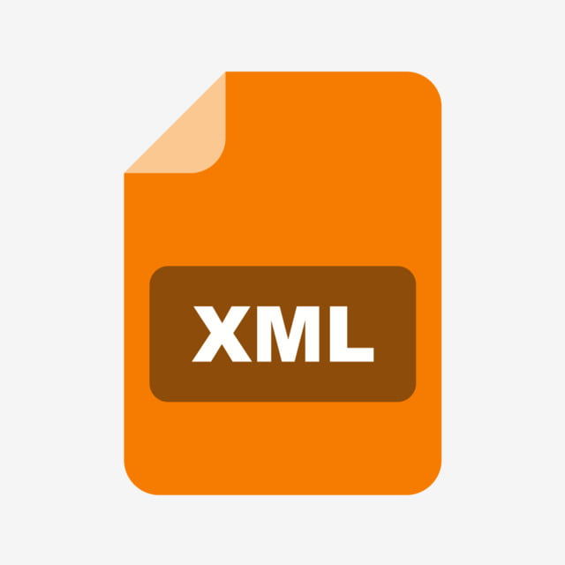


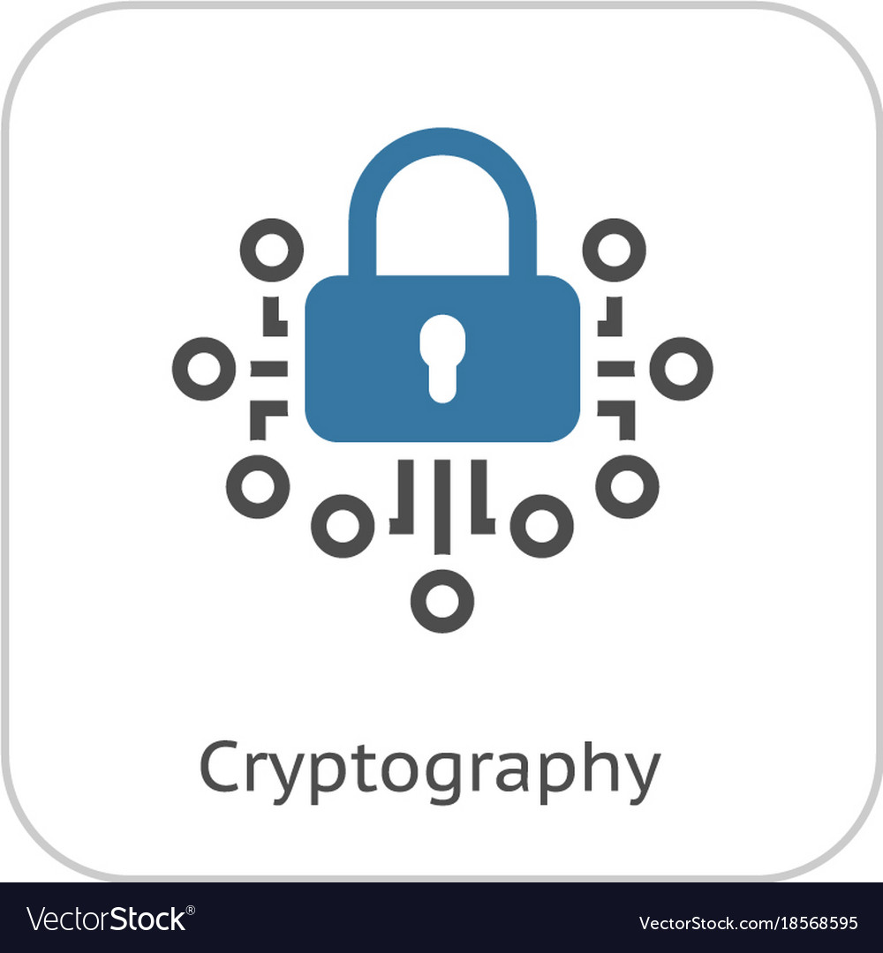
TECHNOLOGY USED
Mobile Platform : Android
Application development tool : Android Studio
Developing language : Java
User Interface Language: XML
Database : Cloud Firestore
Notes Security : AES Algorithm (Cryptography)

Slide 5

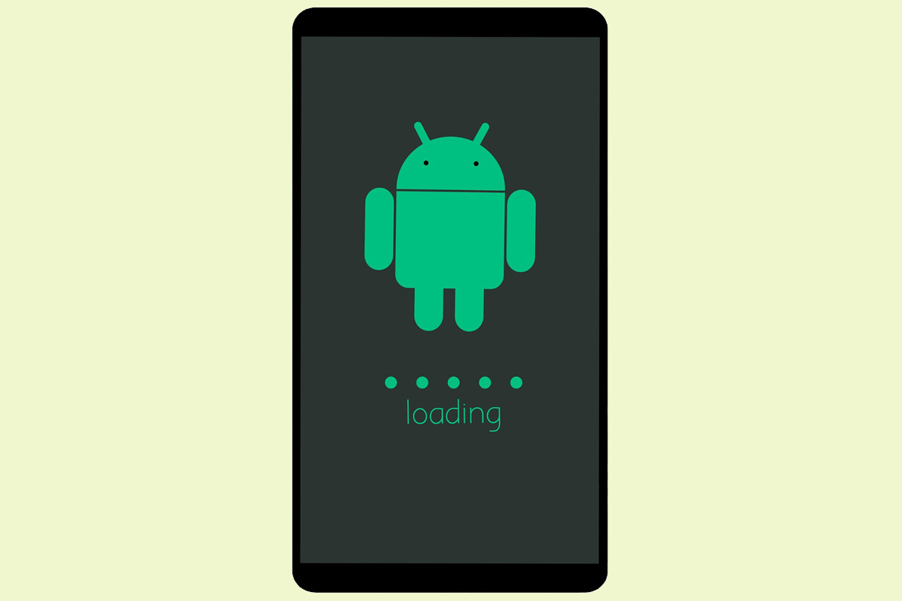
HARDWARE REQUIREMENT
Android API Level 21 and above
Minimum 1 GB RAM
Internet Connection

Slide 6
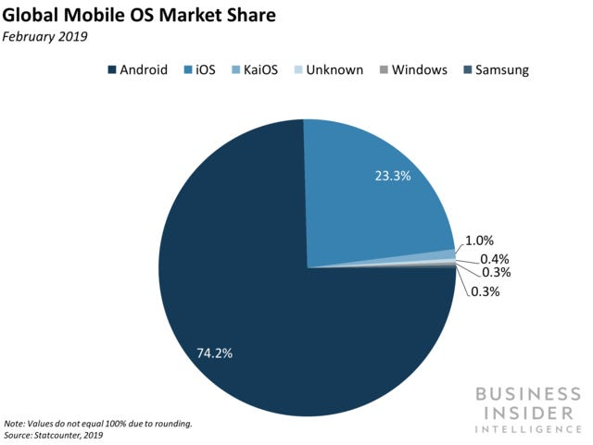
WHY ANDROID ?
Android is Open Source
All Development tools for Android is free
Android has the Largest market share as compare to other OS
Huge Resource is available for developing android Application

Slide 7
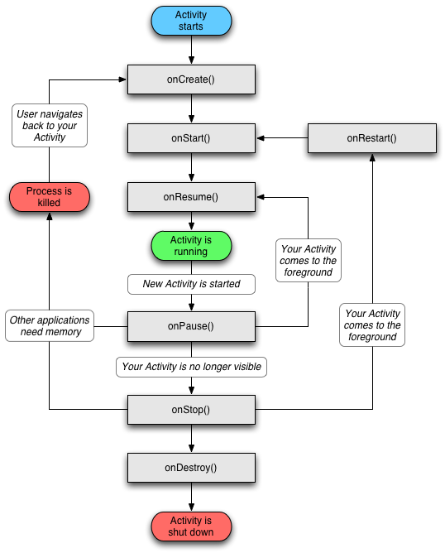
ANDROID ACTIVITY LIFECYCLE

Slide 8
APPLICATION DESIGN OVERVIEW
APP
LOGIN
MAIN ACTIVITY
REGISTER
MAIN ACTIVITY
ADD
EDIT
DELETE
SEARCH
SHARE

Slide 9
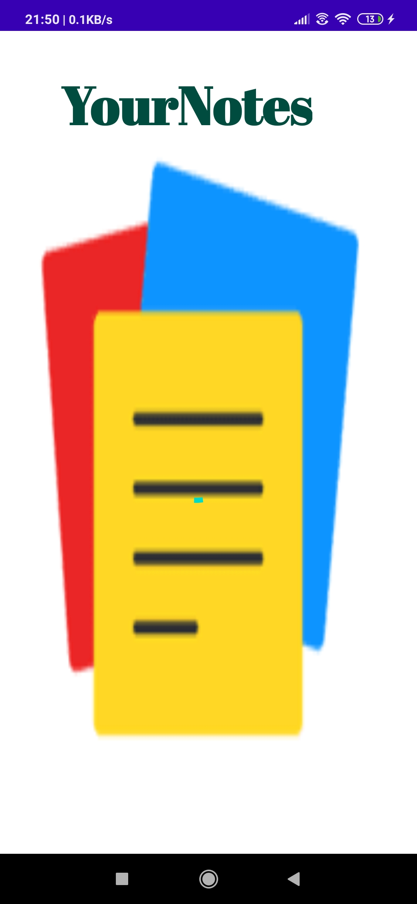
SNAPSHOTS
This is splash screen shown for 2 second after which , Register Activity will Open

Slide 10
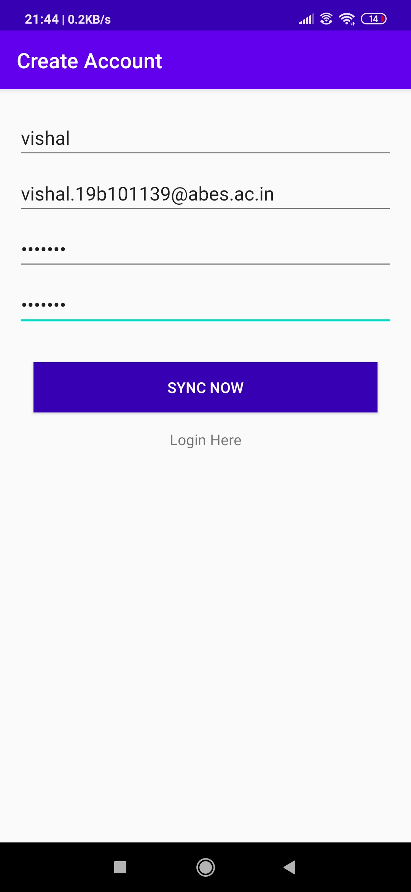
This is registration Screen
Where user can register if it is not registered in our app, Otherwise it can Log In My App

Slide 11
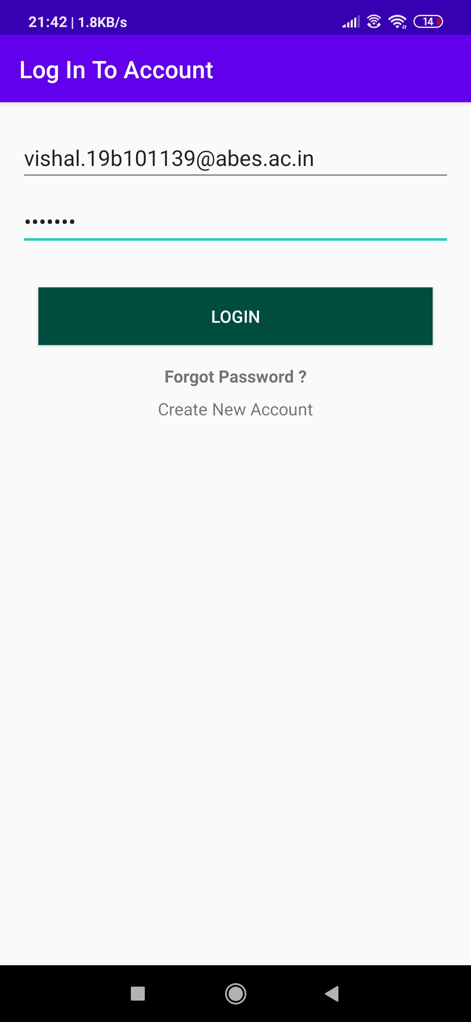
This is Login Screen , Where User can Log In in My App , if it is Already Registered

Slide 12
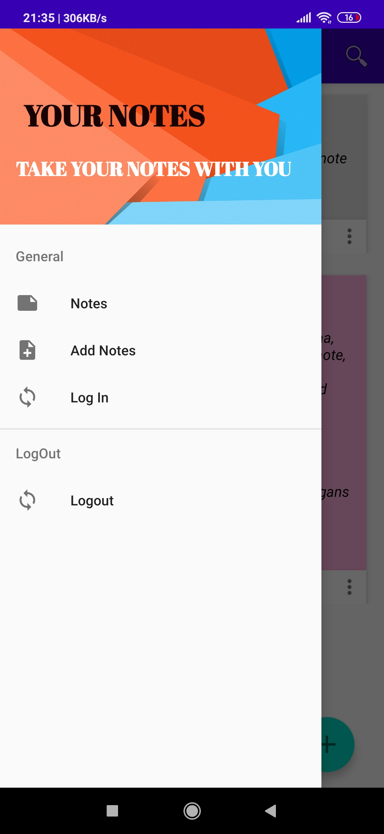
This is the main Screen Where all,the user Notes are displayed, First Notes are decrypted and then displayed
This is the Navigation View from which user can Log Out and Add Notes

Slide 13
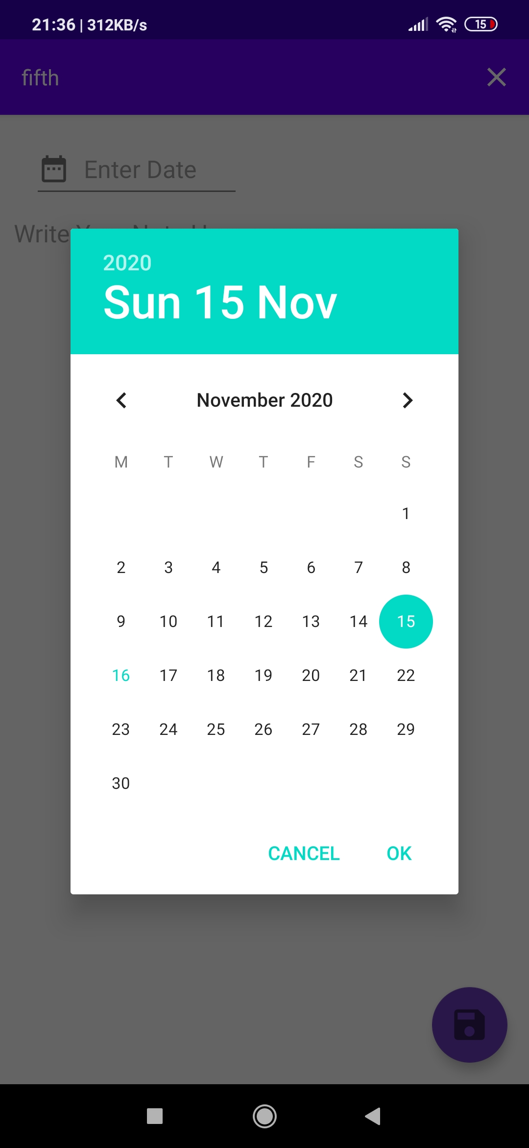
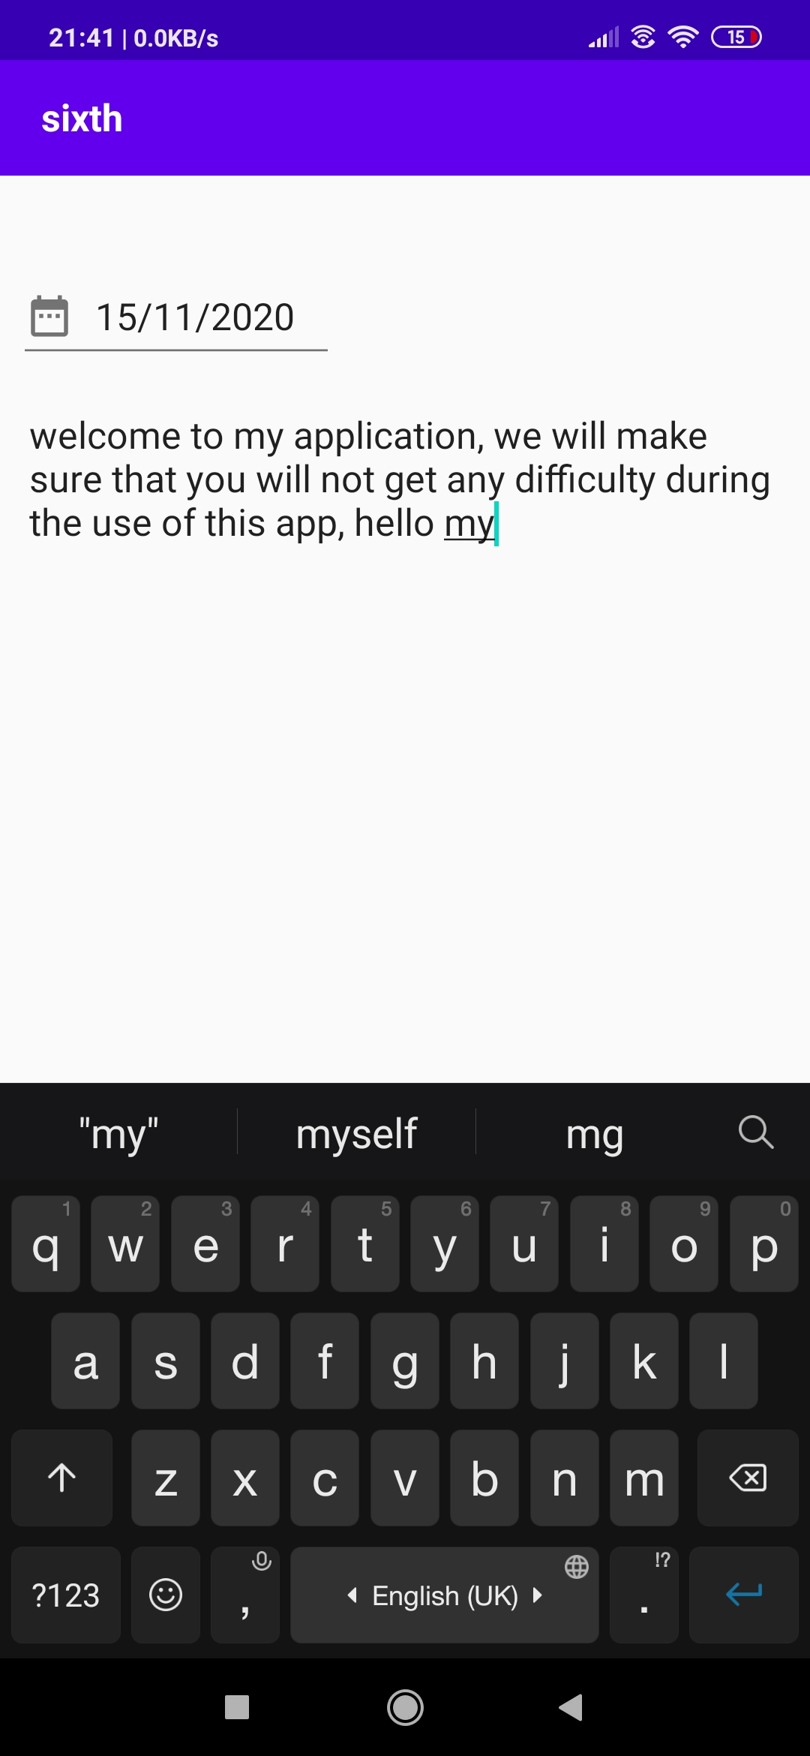
In this Screen User Can Add note According To date, then note is
Encrypted and Save to User
Account
In this Screen User
Can edit note and then note is encrypted and then save to user account

Slide 14
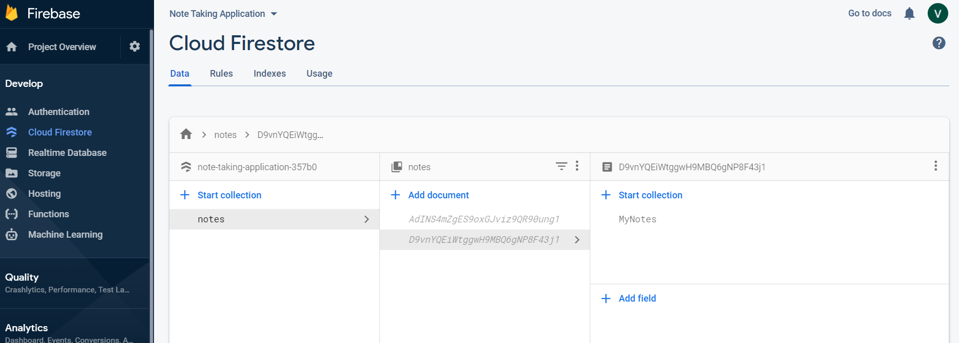
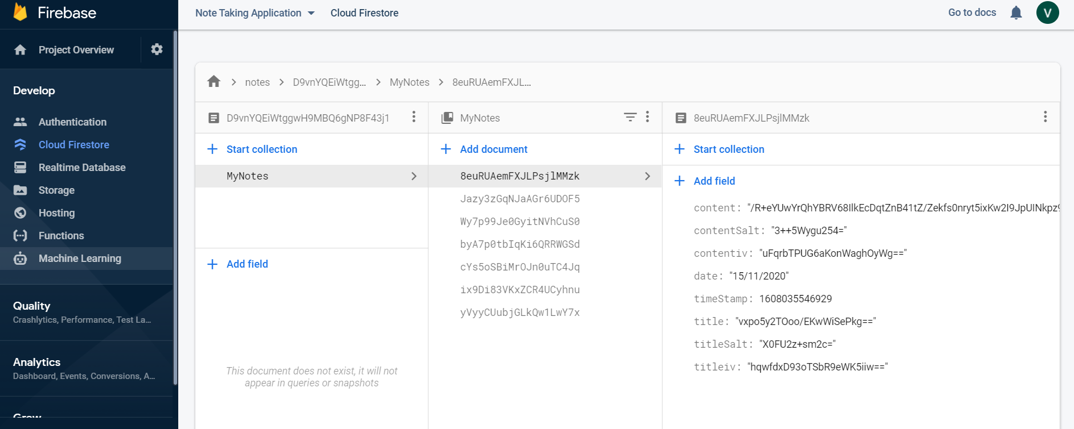
User Data is Stored In Encrypted Form in Cloud Firestore

Slide 15
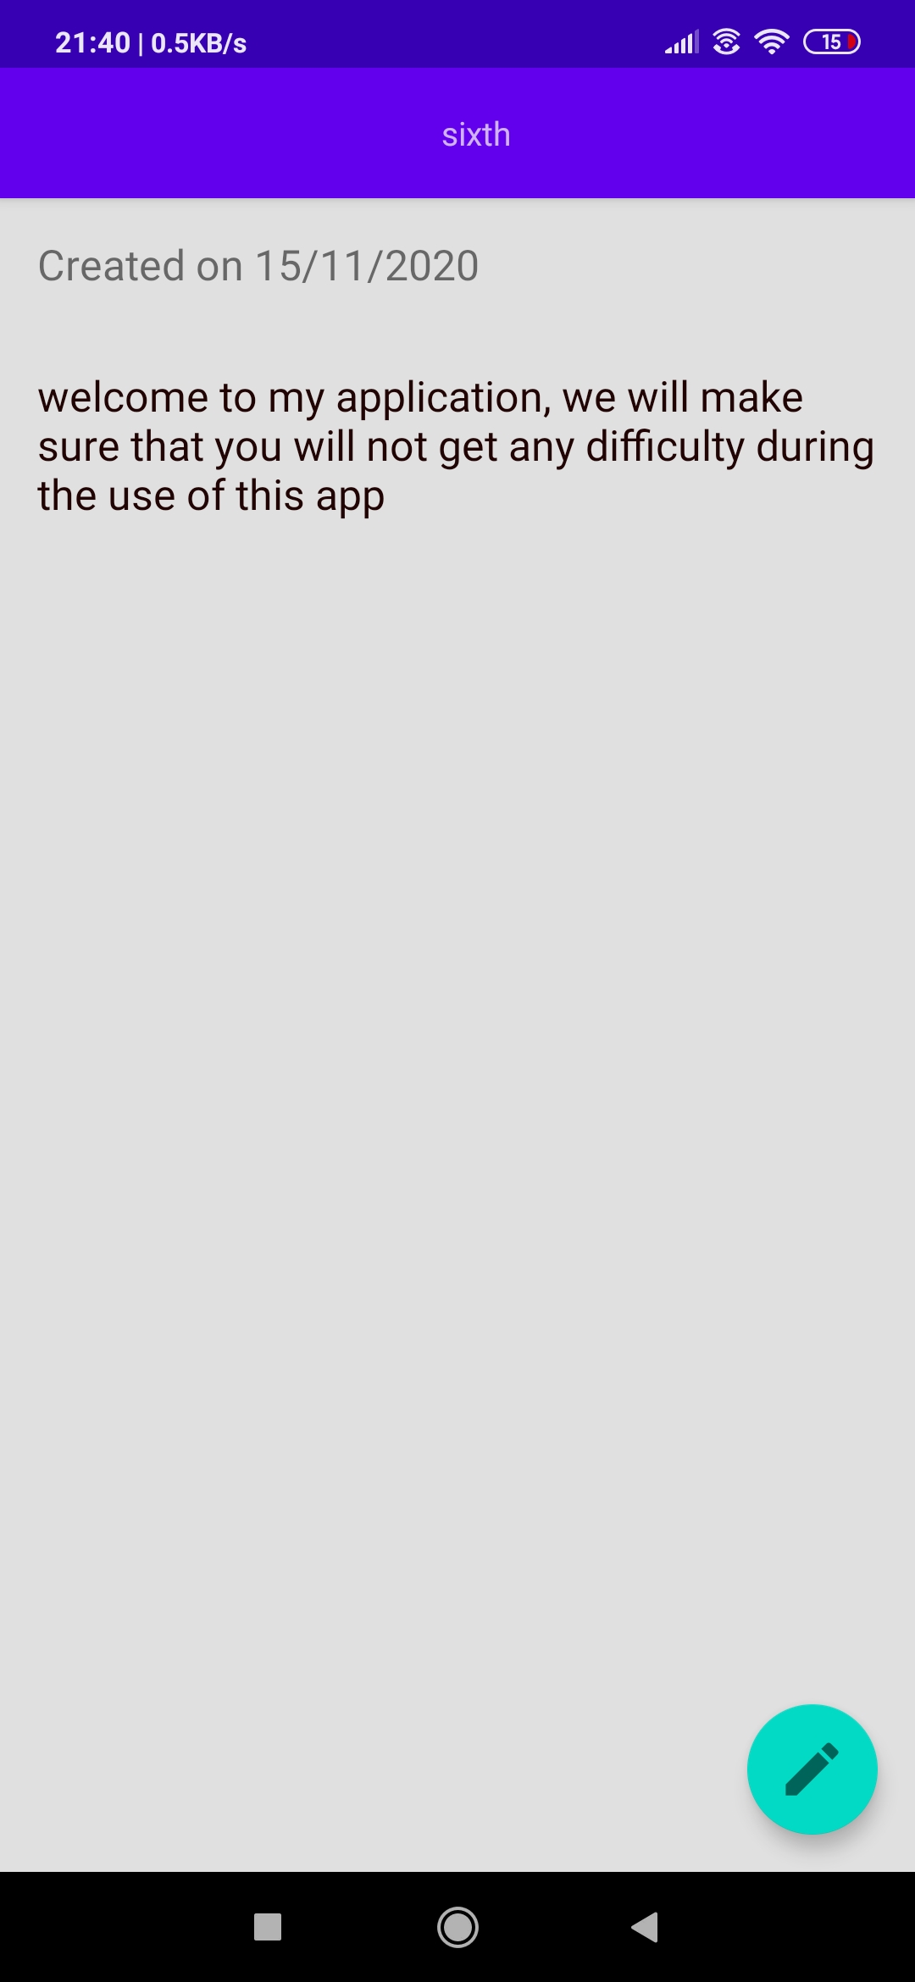
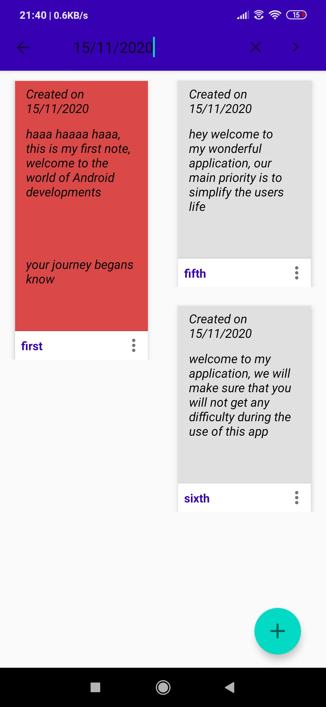
In this Screen User can View their Notes Properly
User can also
Search their Notes
According to date

Slide 16
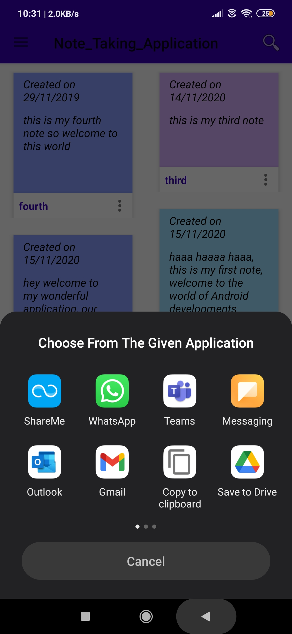
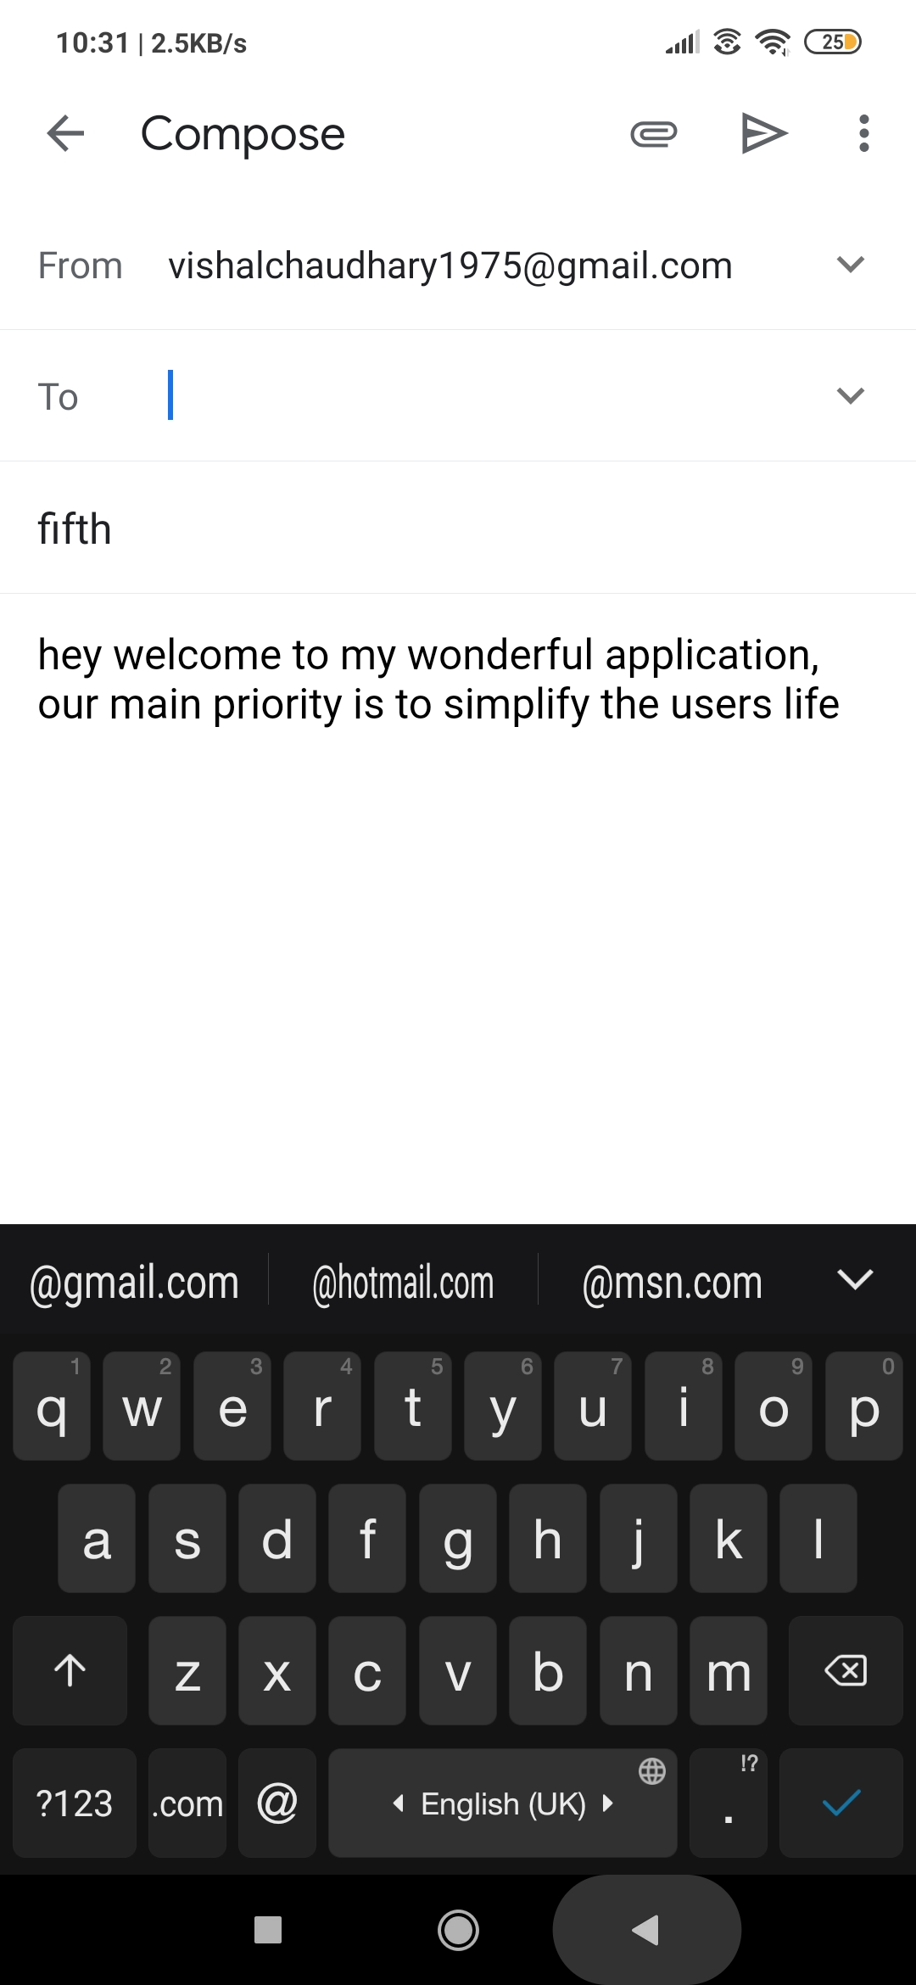
User can also Share notes with their friends, with the help of Our App through Social Networking site. Such as Gmail,WhatsApp

Slide 17
FUTURE WORK
Future development for this project might involve further improving the application itself and creating a website that would work alongside the application.
There are many feature I can add in this app such as allowing user to add audio, video, and images to notes, it will increase the flexibility of the app , there is a huge scope of improving the UI of the app for improving the experience of user will using my app
I can also make website that work along with this app, so that user can access the notes through website also.

Slide 18
LEARNING FROM PROJECT
Android App Development Fundamental
Familiarity With Android Studio
Java Programming Language
Use of XML for User Interface
Use Of Firebase and Cloud Firestore
Basics Of Cryptography

Slide 19
Thank You All
by
VISHAL SINGH CHAUDHARY
1900320100199
2019b101139
CSE-C

